Slide 1
분판 CELL Axis Name
21.12.01

Slide 2
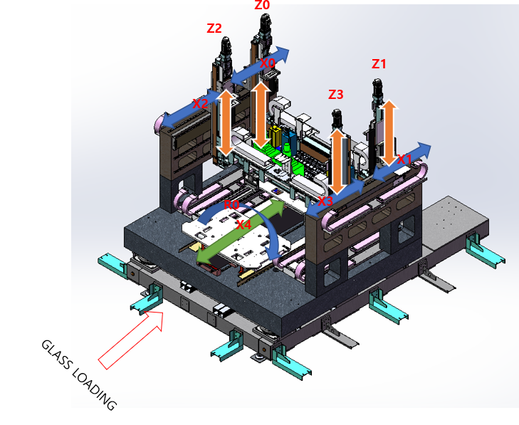
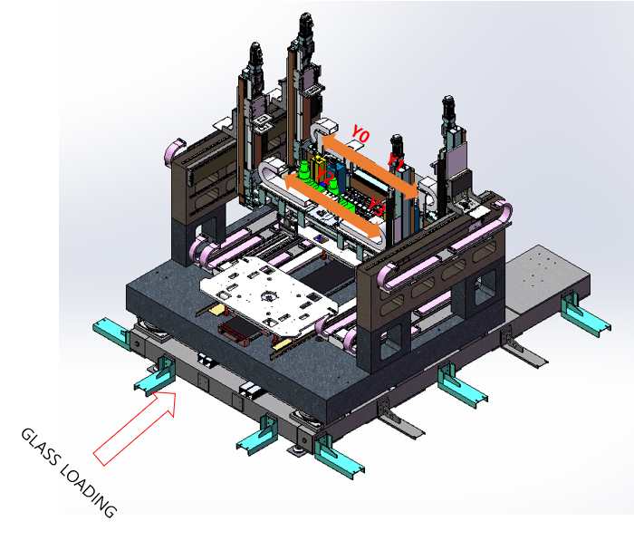
* 등각도-FRONT
SP_X

Slide 3
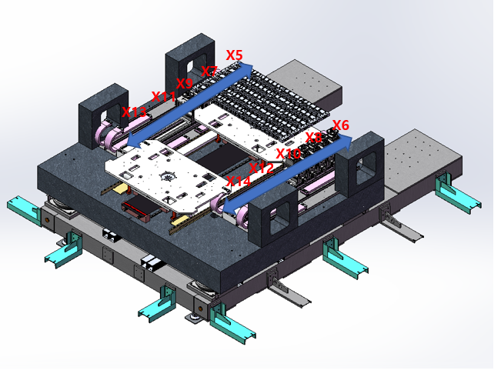
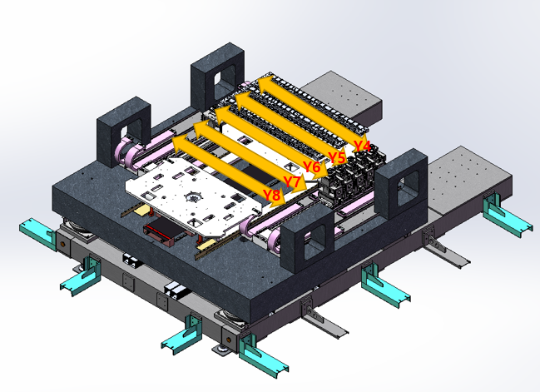
* 등각도-FRONT
X6
X4
X8
X10
X12
X5
X7
PY0
X9
PY1
X11
PY2
X13
PY3
PY4

Slide 4
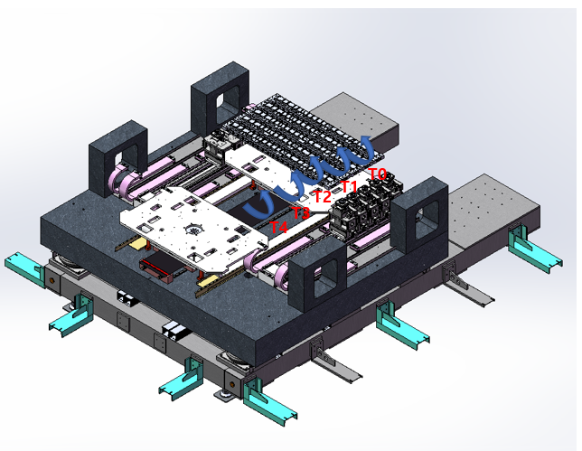
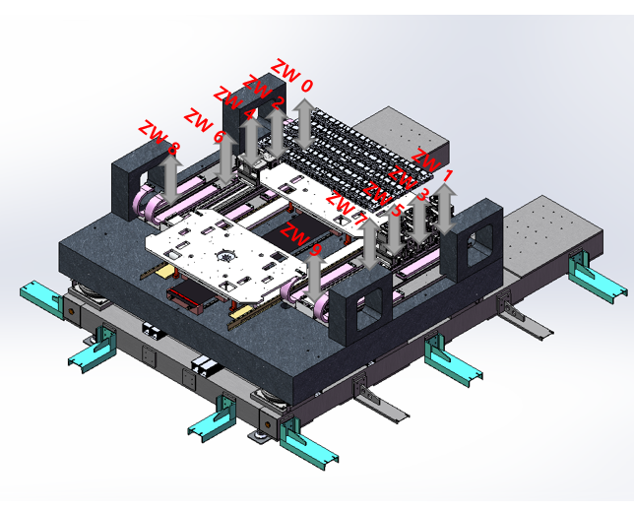
* 등각도-FRONT
UZ0
UZ2
UZ4
UZ6
UZ8
UZ1
PYAW0
UZ3
PYAW1
UZ5
UZ7
PYAW2
UZ9
PYAW3
PYAW4

